Slide 1


PATTERN PROGRAM
28 SEPTEMBER 2024

Slide 2

Team Members:
Sri Vatsav Chaitra c m Moulya Anuradha Indu A S Sai Pruthvi

Slide 3

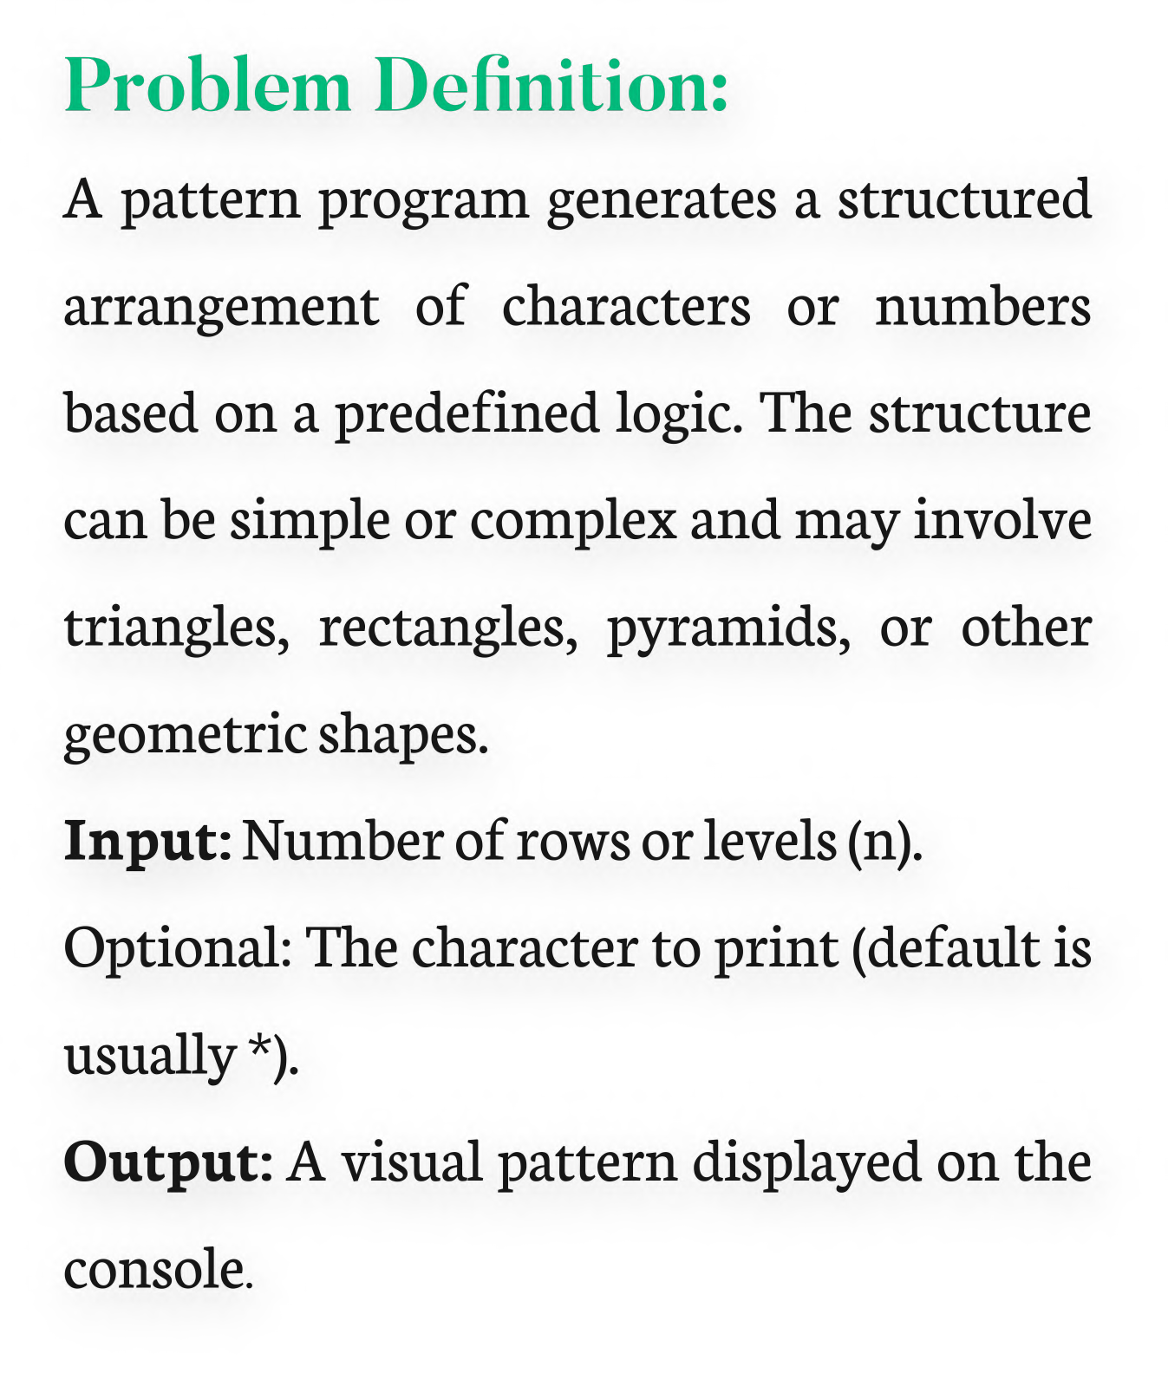
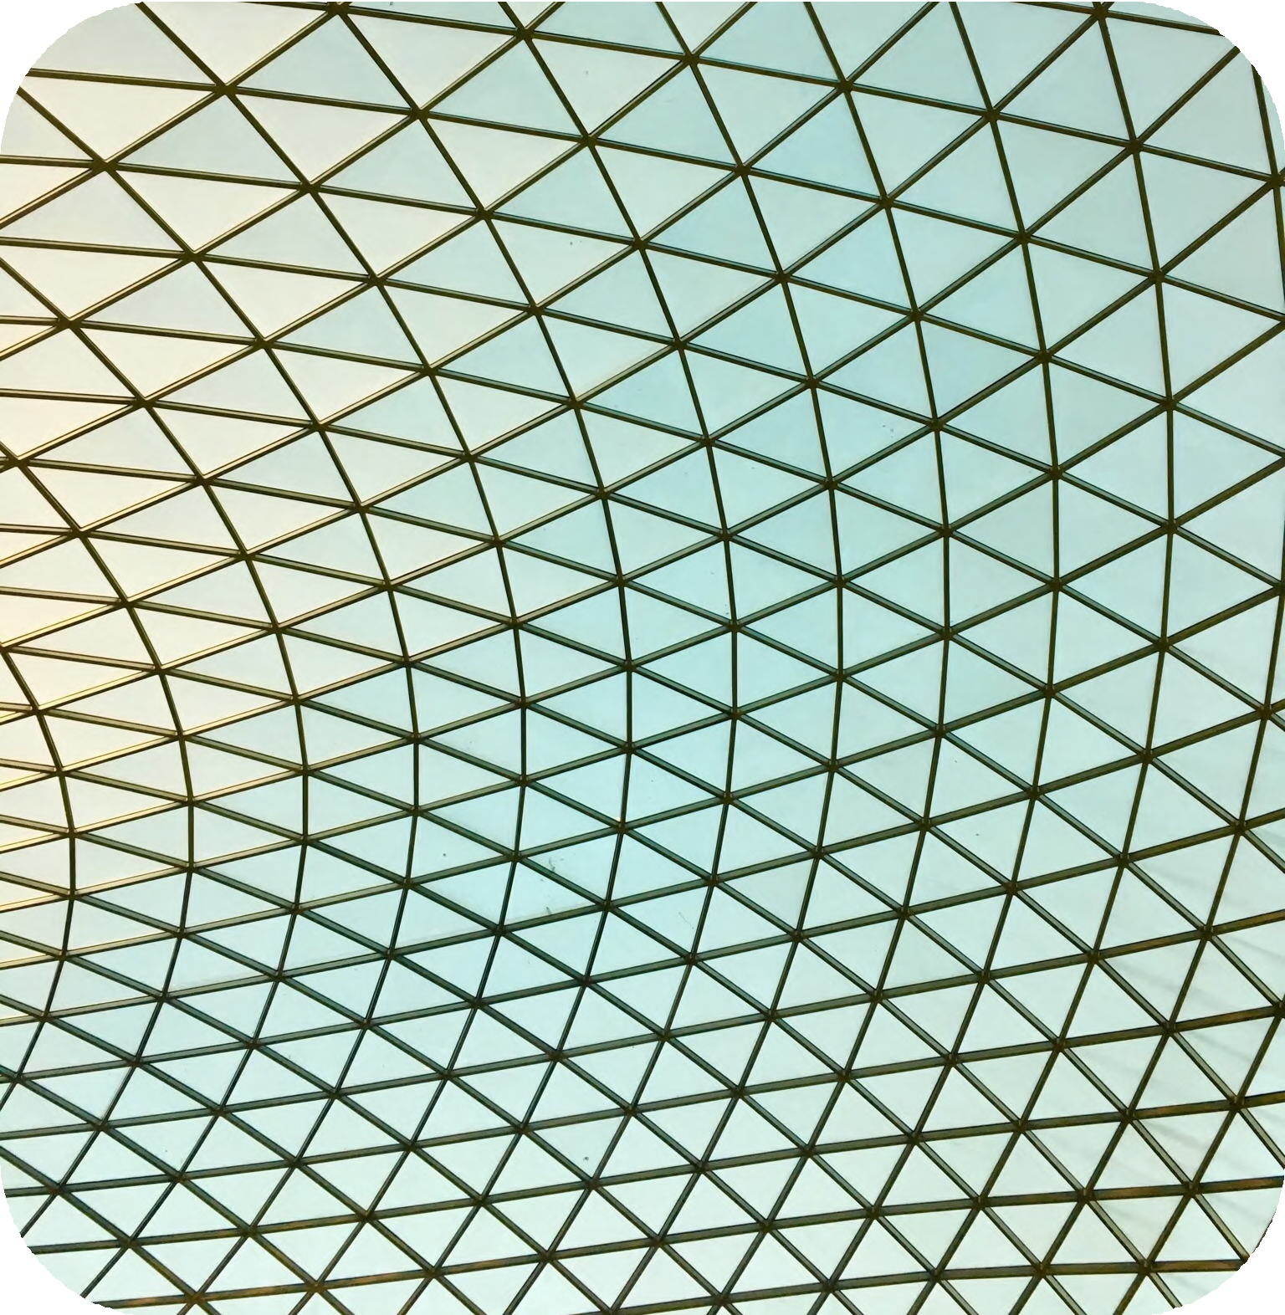

Slide 4
Algorithm Outline
The general algorithm to solve a pattern program follows these steps: 1.Take user input (n), which defines the size or number of rows.
2.Use nested loops:
The outer loop controls the rows.
The inner loop controls the columns or characters to print in each row. 3.Depending on the pattern type, control the logic inside the inner loop.
4.Print the result
Time and Space Complexity:
Time Complexity: O(n^2) for most patterns, where n is the number of rows, due to the nested loops.
Space Complexity: O(1) if we are printing directly to the console

Slide 5
Conclusion:
This documentation provides a general overview for pattern program development. The specific logic can be adapted based on the desired pattern. These patterns not only help in enhancing
logical thinking and problem-solving skills but also provide a solid understanding of how nested loops work in different programming languages.
THANK YOU

